Slide 1
Havana Harbor

Slide 2
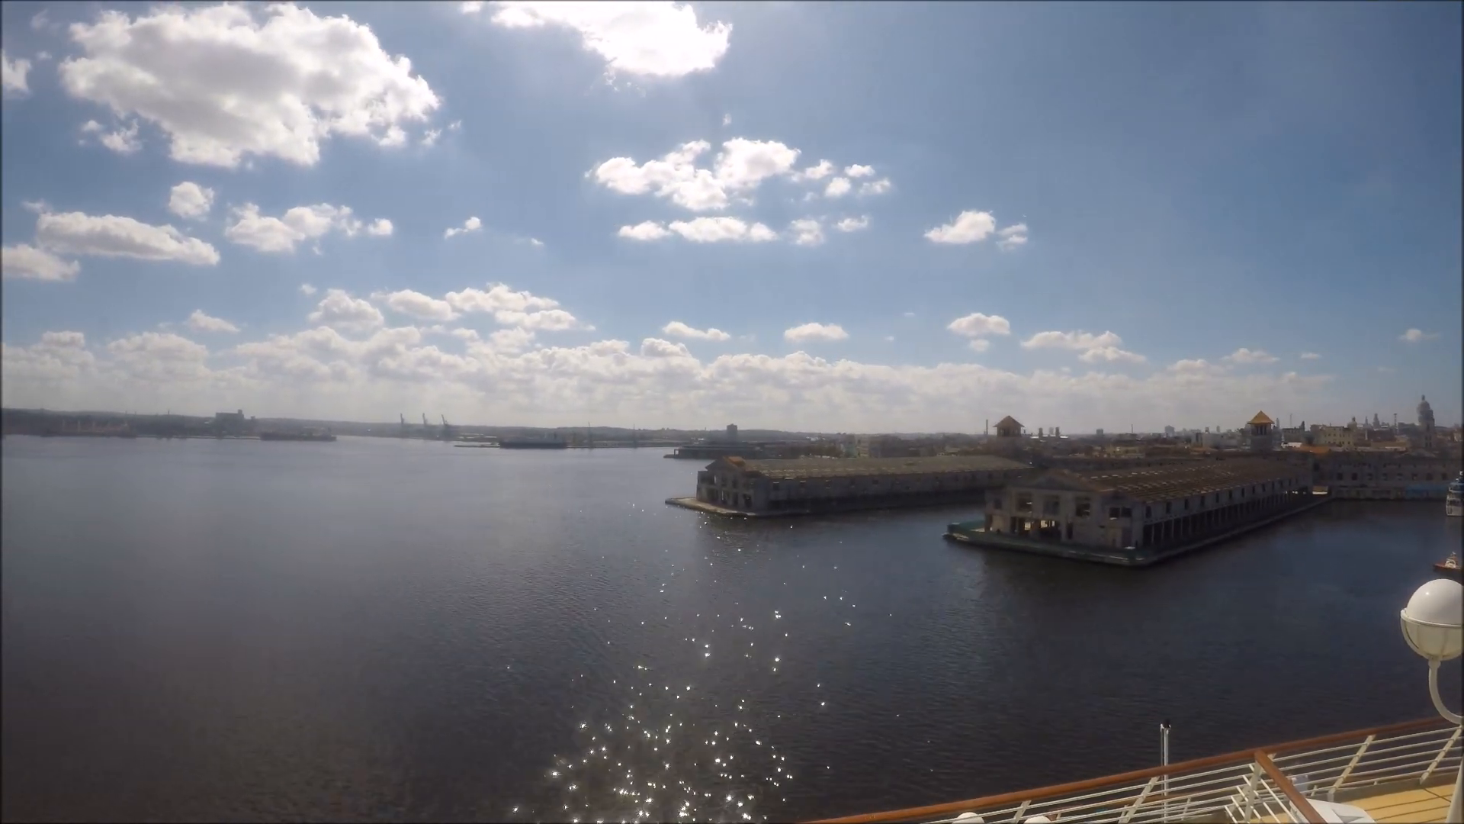
1

Slide 3

2

Slide 4
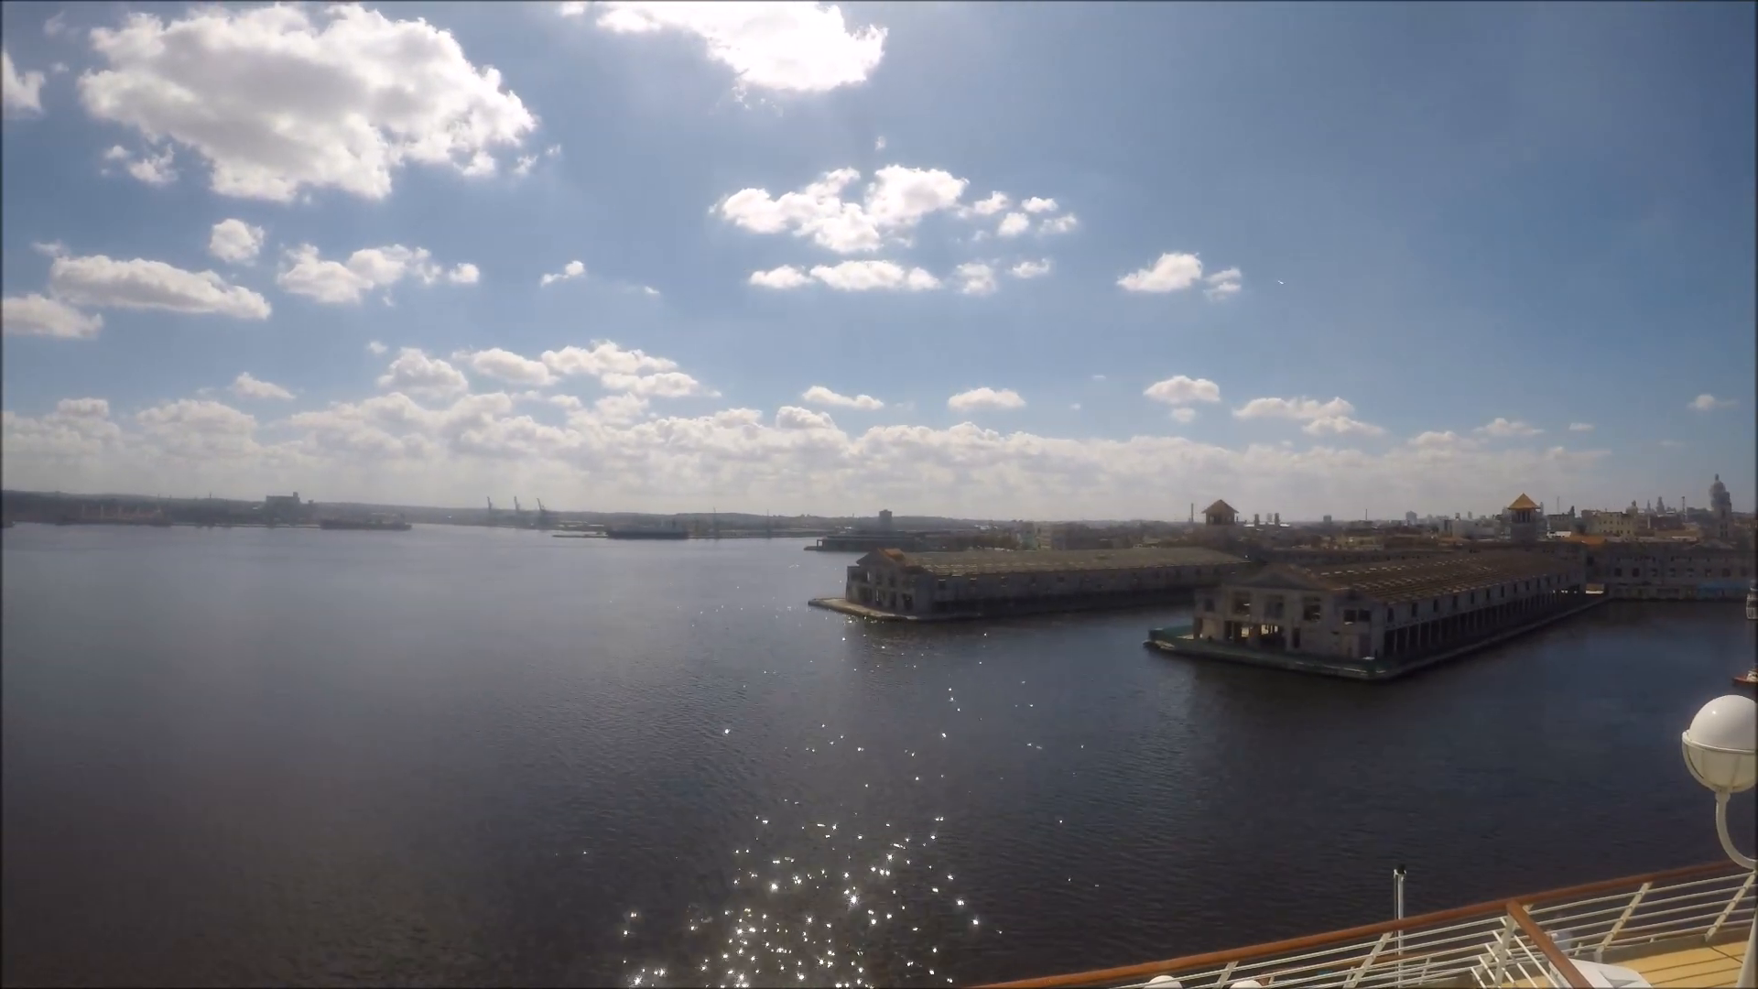
3

Slide 5
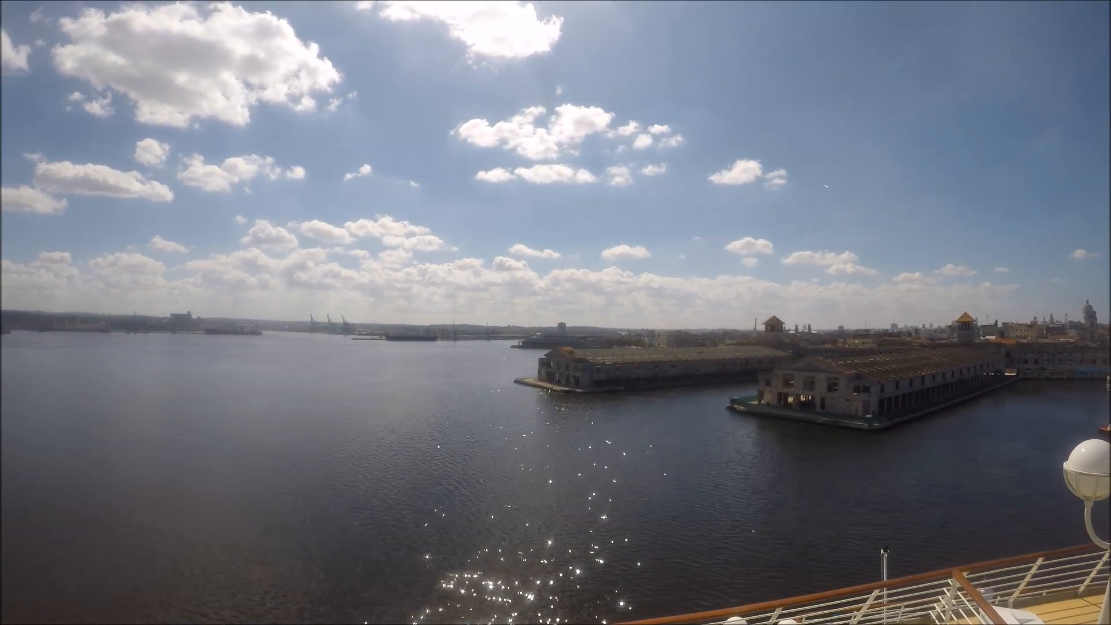
4

Slide 6
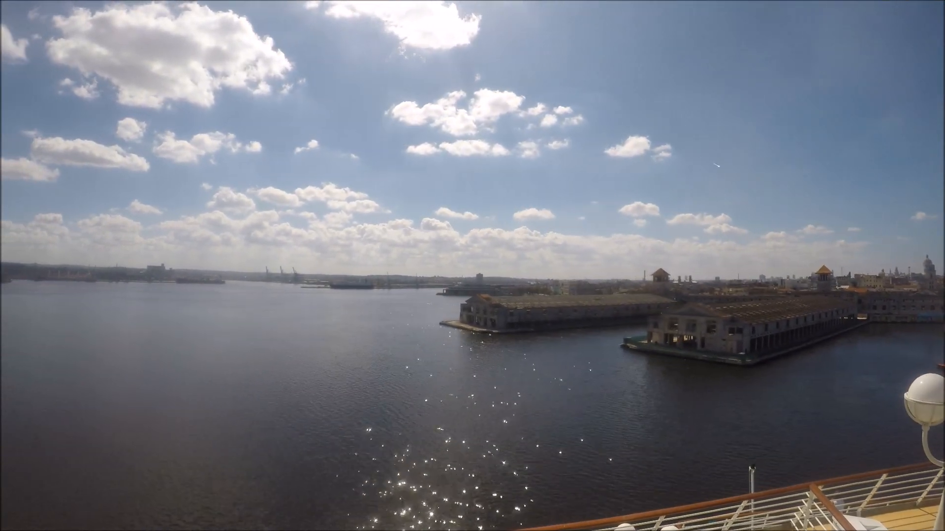
5

Slide 7
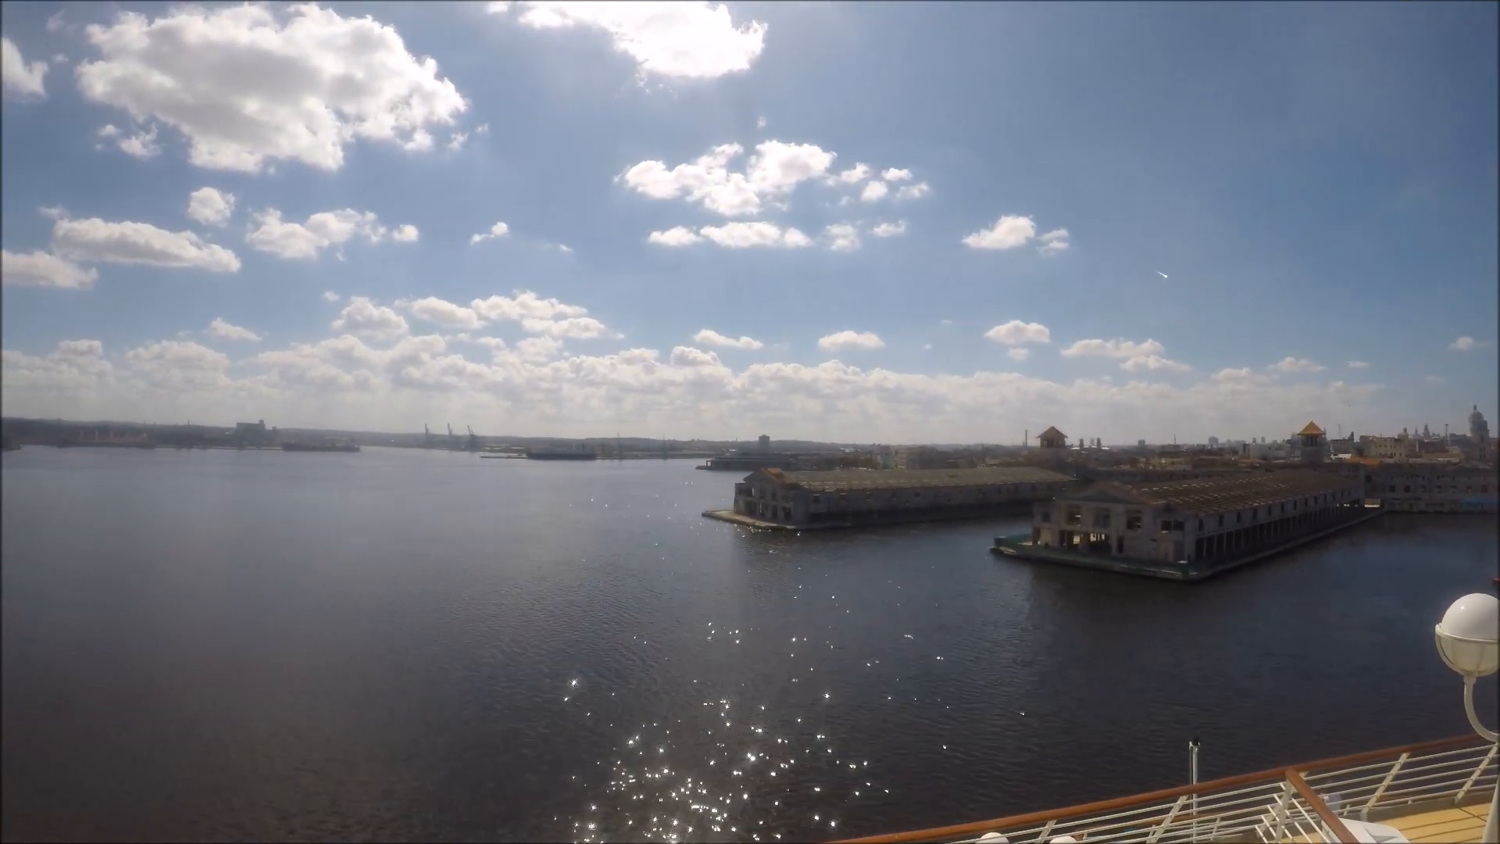
6

Slide 8
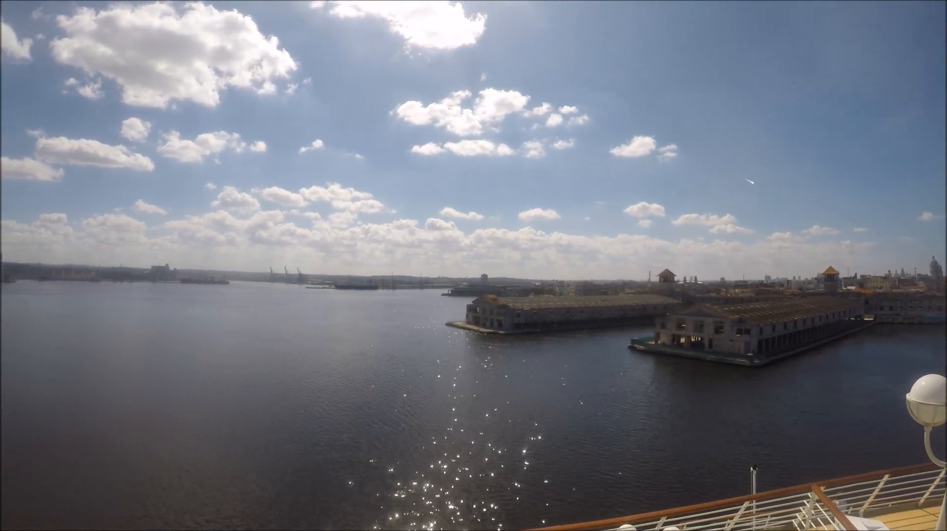
7

Slide 9

8

Slide 10

9

Slide 11

10

Slide 12

11

Slide 13
Ft. Myers Beach, FL (USA)

Slide 14
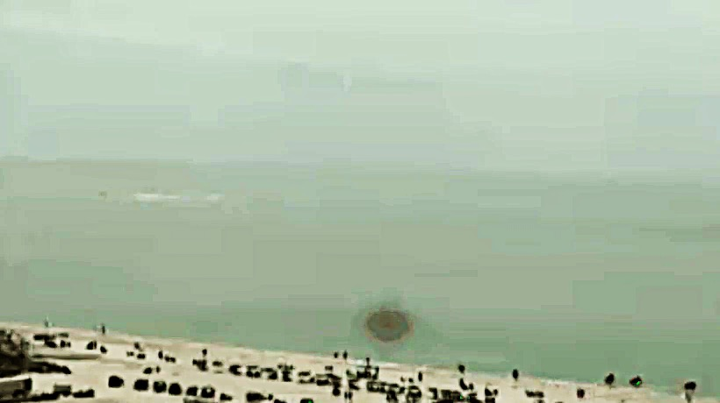
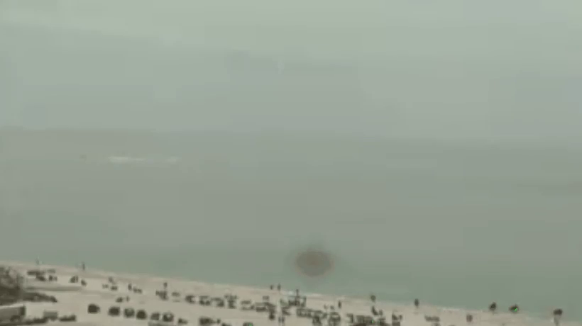
5

Slide 15
5

Slide 16

7

Slide 17


Slide 18


Slide 19


Slide 20
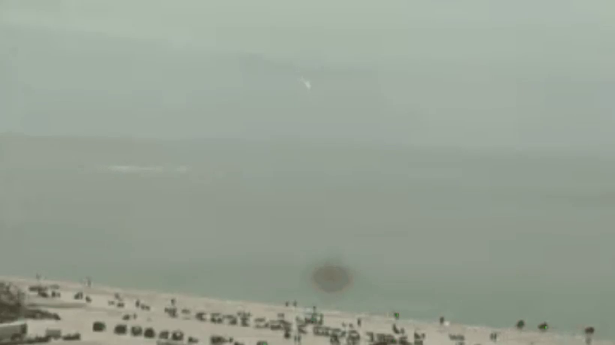

Slide 21


Slide 22
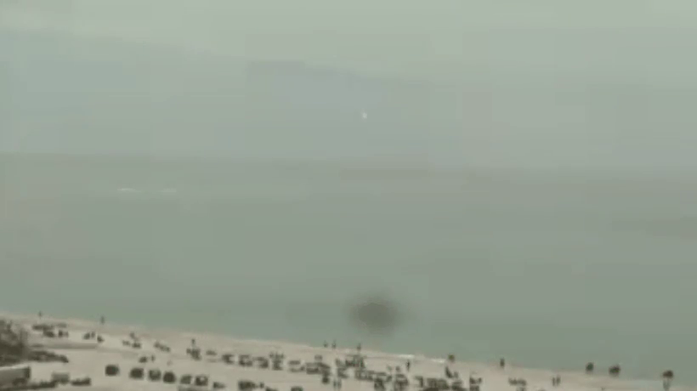

Slide 23
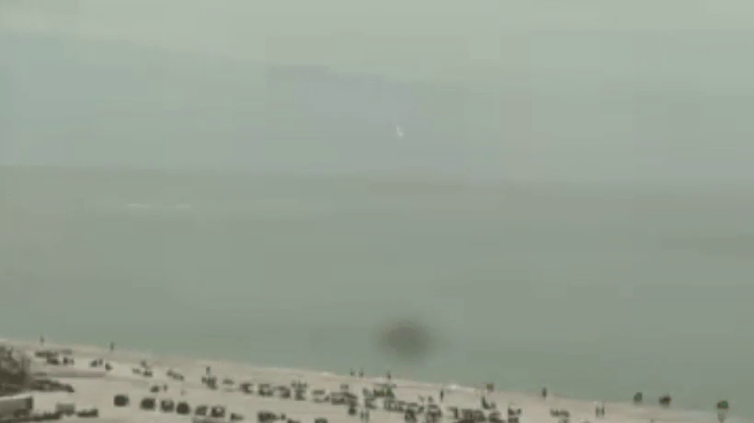

Slide 24
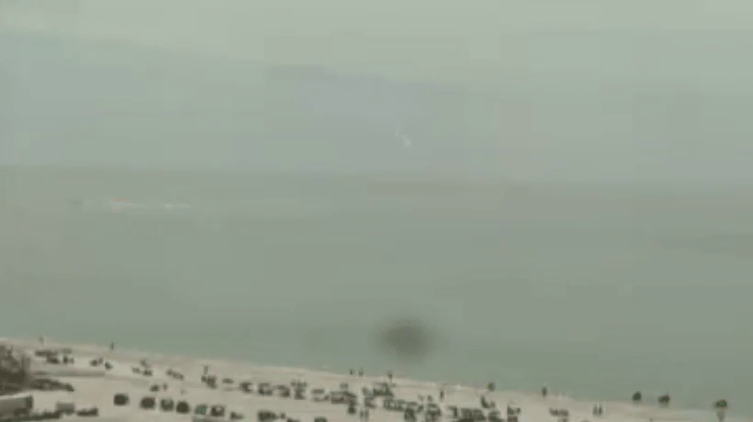

Slide 25
Alameda, Pinar del Río (Cuba)

Slide 26

Image 1

Slide 27

Image 2

Slide 28
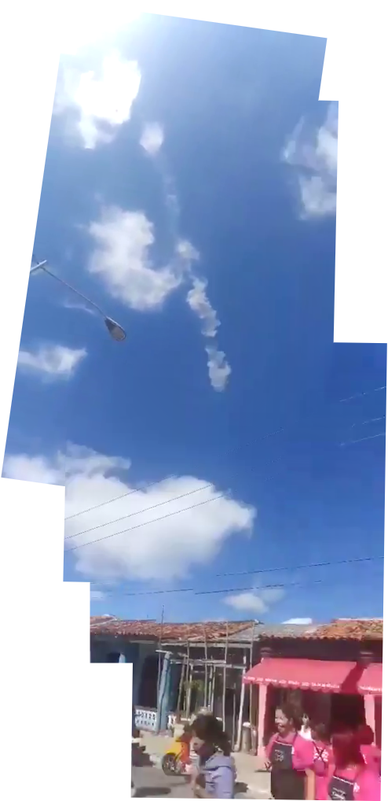
Panorama 1

Slide 29
Panorama 1

Slide 30
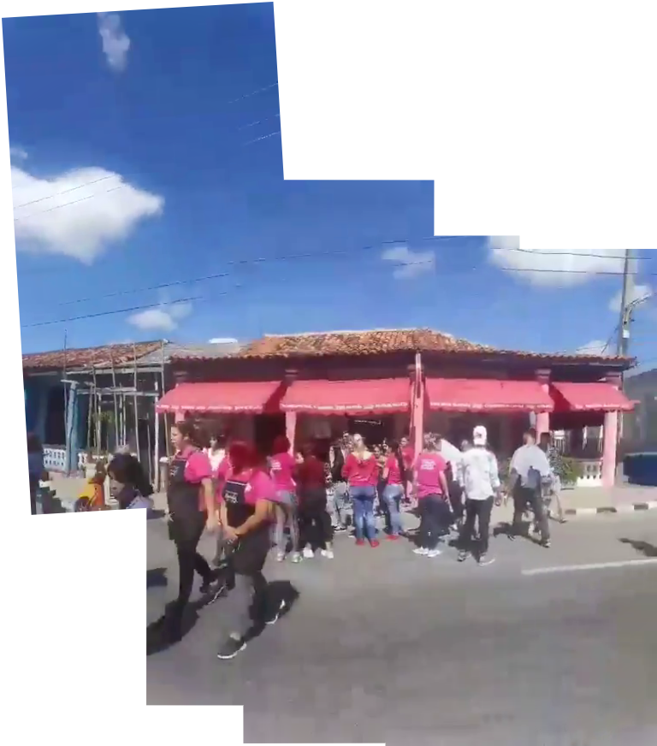
Panorama 2

Slide 31
Illustrations

Slide 32
Picture: Rachel Cook, @rachelcook
Meteor
Terminal Portuaria
South Tower
North Tower
Cuiser Deck

Slide 33
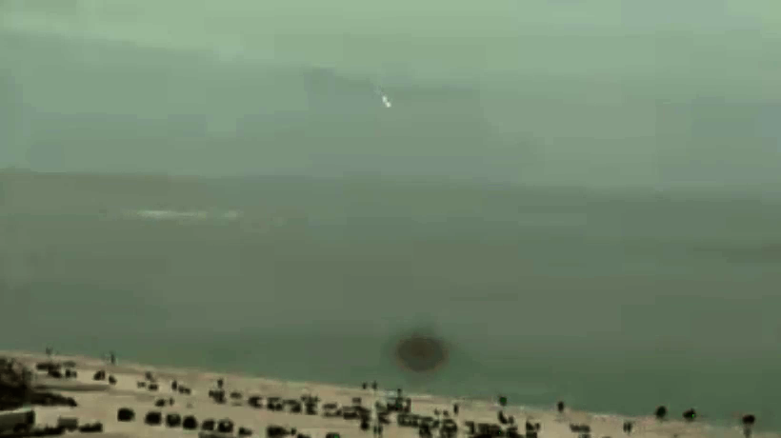
Picture: EarthCam, https://www.earthcam.com
Meteor
Sea line (astronomical horizon)
Truck, Jet Sky Loan
Beach line

Slide 34
Towards the Sun
Smoke trail
Street light
Meteor motion
Alameda’s houses

Slide 35
Google Earth Comparisons

Slide 36
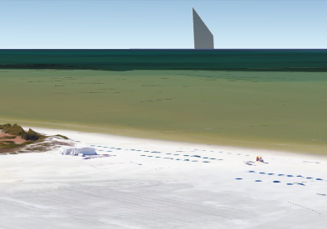

Slide 37
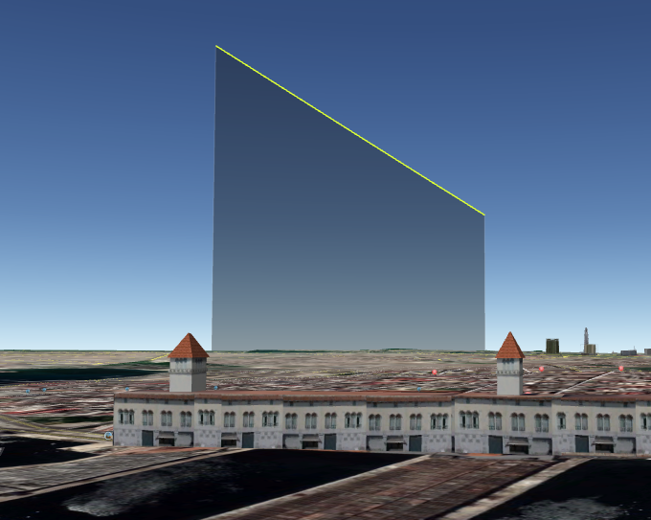

Slide 38


